Slide 1
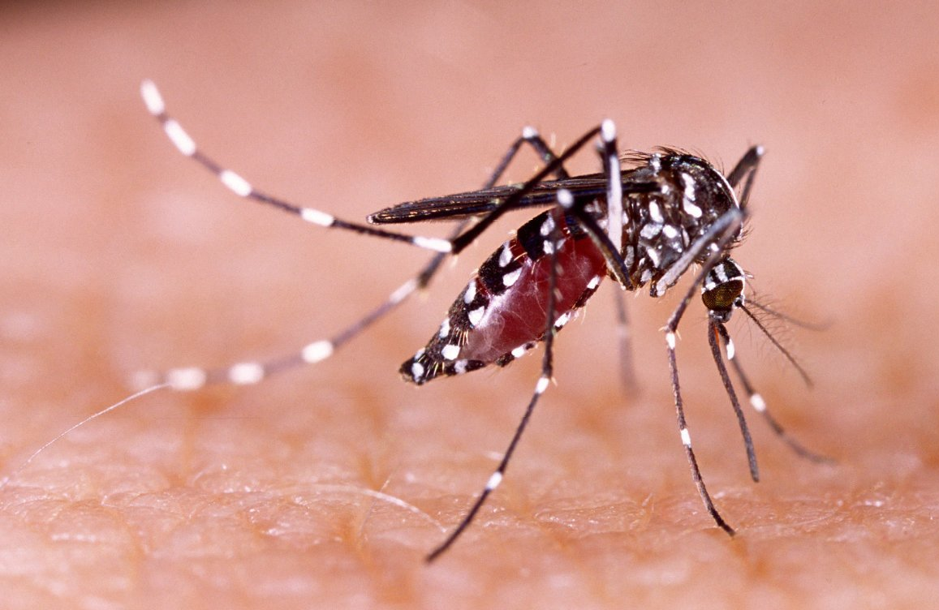
Temperature sensitivity of Dengue in Thailand
Project Proposal
Thaddeus Kühn, Dana Levi, Fiona Tanner, Frederik Racky
https://www.wissenschaft.de/wp-content/uploads/2/0/20-01-17-dengue.jpg

Slide 2
Overview
Background Data
Methods Milestones
Ideas Timeline

Slide 3
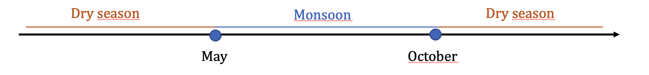
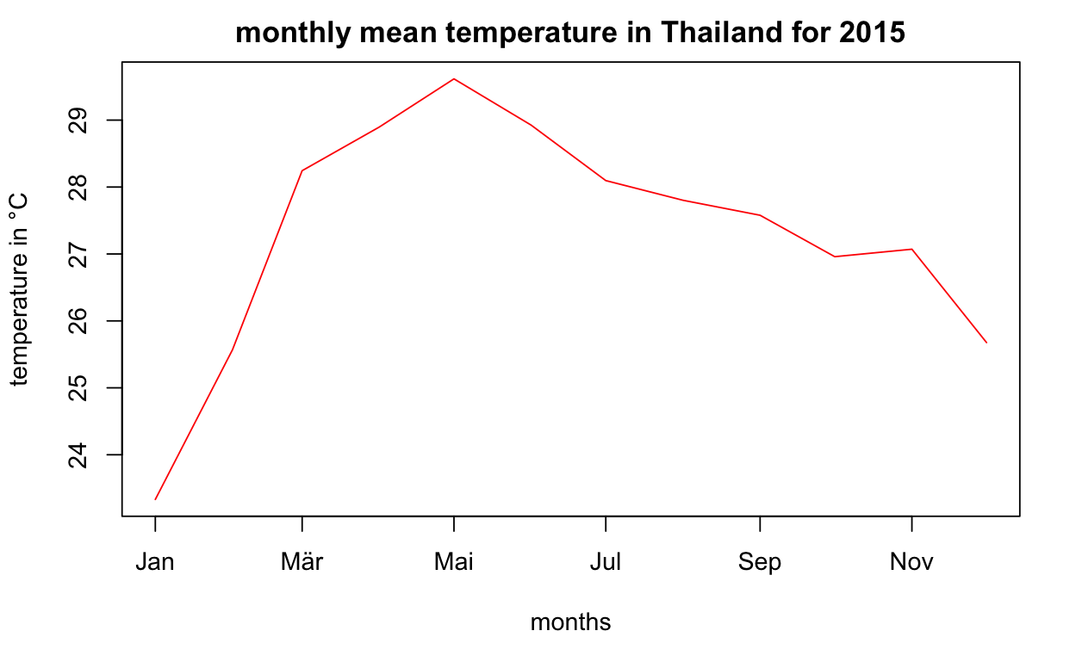
Climate
Notes:
Always warm in comparison to rest of world
Dry season: winter months are colder, march to may hottest months
Monsoon: may to oct, heavy rains, warm but decreasing temperature

Slide 4
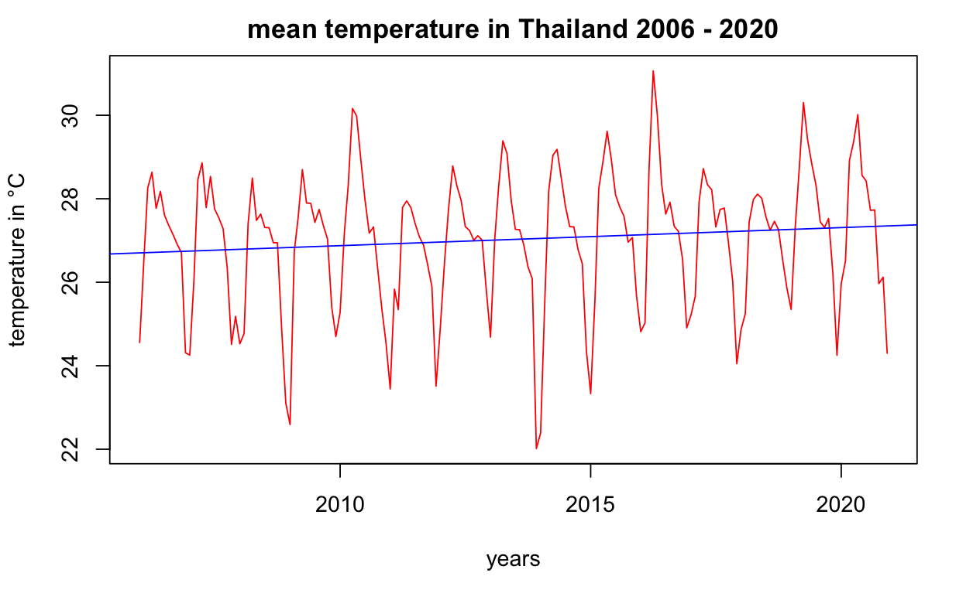
Climate
Notes:
Masud et al. Investigated climate in northern thailand -> Trends: rising min and max temperature in northern thailand, no significant rise in max in spring
We look at the whole country: slightr riding trend, check significance for distinct seasons
Minimum temperature in december 2013 -> thailand mean = 22 °C
Maximum temperature in april 2016 -> thailand mean = 31 °C
Every 5-6 years an extreme low/ high temperature is hit -> interesting to investigate if there is correlation to dengue data

Slide 5
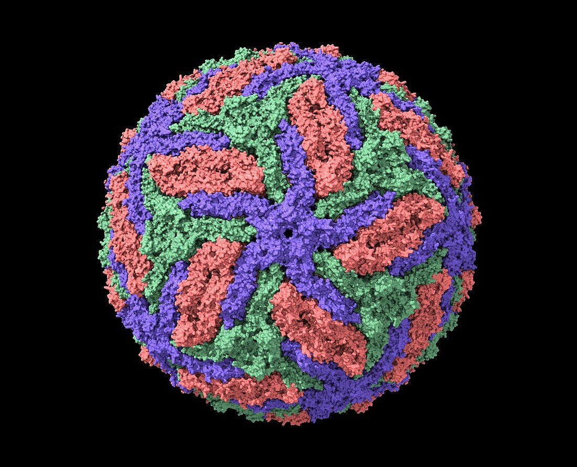
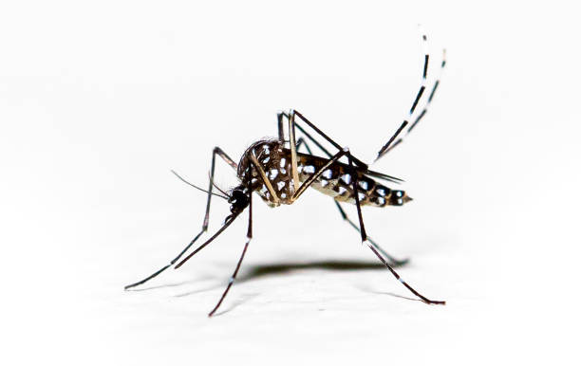

Dengue
https://media02.stockfood.com/largepreviews/NDE1NTg0NDgx/13405951-Dengue-virus-computer-model.jpg
https://media.istockphoto.com/id/1263464608/de/foto/aedes-aegypti-mosquito-pernilongo-mit-wei%C3%9Fen-flecken-und-wei%C3%9Fem-hintergrund.jpg?s=612x612&w=0&k=20&c=C3-vCzQG5kHMUMrfRKB1z1k5V7tmJkI6HpfEVtO6Hes=
Serotypes:
DENV 1-4
Aedes albopictus
Aedes aegypti
Notes:
Dengue fever is caused by dengue virus (four serotypes)
Vector borne -> transmitted by aedes mosquitoes, two types not distinguished in our study
Dengue hemmorhagic fever is characterized by fever, headache, bleeding/ bruising, joint/ muscle pain
WHO: 100 – 400 milllion infections worldwide / year (asia, africa, america)
No specific treatment -> major public health issue

Slide 6
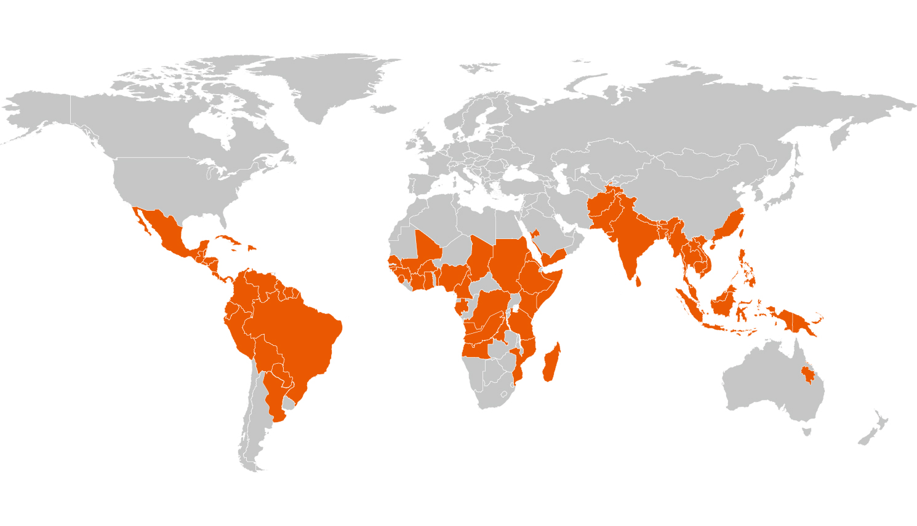

Dengue Virus
Viral infection caused by the dengue virus
Transmitted by the Aedes mosquitoes
Worldwide about 390 million infections per year
Major public health issue according to WHO
South-East Asia one of the most seriously affected areas
No specific treatment yet
Analysis and predicition are important strategies to prevent infections
https://www.euroimmunblog.de/dengue-diagnostizieren/

Slide 7
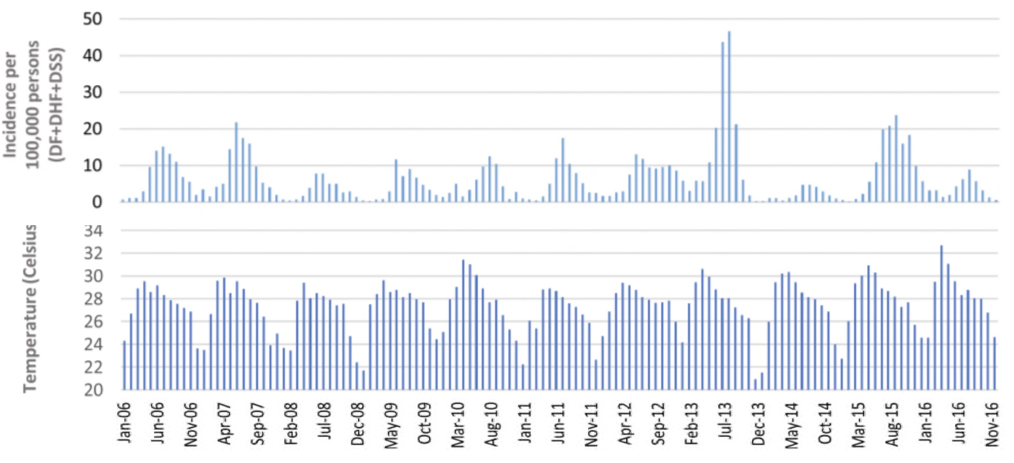
The relation between temperature and dengue
Climate variables are potential predictors of dengue transmission
Panichat et al:
maximum temperature positively associated with higher incidences
Most dengue cases occur at mean tempuratures beween 27 °C and 29.5 °C with a a maximum at 29°C
Development of Dengue cases and temperature in Thailand
https://www.ncbi.nlm.nih.gov/pmc/articles/PMC6708185/

Slide 8
Datasets
TEMPERATURE
ERA5 database
Monthly 2m temperature
2006 - 2022
DENGUE
DHF data
Total monthly infections per district 2006 - 2020
POPULATION
Data from 2012 – 2020
Estimates for 2006 – 2011 (linear regression model)
Notes:
ERA5 Data:
measurements, reanalysis of climate data since 1959 (hourly, 0,25°x 0,25° spatial resolution, 137 altitude levels (max. 80 km)
Extraction of monthly 2m temperature data from 2006 – 2022
Dengue data:
Dengue hemmorhagic fever
Monthly infections in every thailand province (77)

Slide 9
Further investigation ideas
How does temperature affect dengue mortality?
How do urbanized areas affect infection rates?

Slide 10
Sources
Masud, M. B., Soni, P., Shrestha, S., & Tripathi, N. K. (2016). Changes in climate extremes over North Thailand, 1960–2099. Downloads.Hindawi.Com, 1960–2099.
*dengue source*

Slide 11
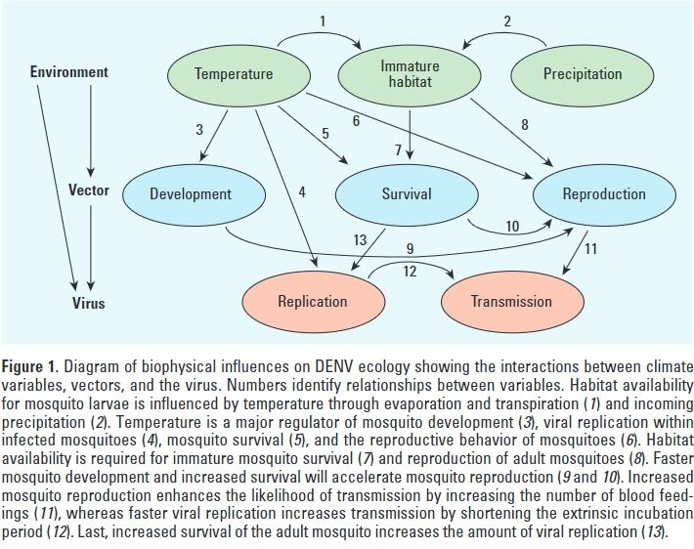
The effect of higher Temperatures on Aedes mosquitoes
Increased larval development
Higher rate of multiple feeding
Extrinsic incubation period declines
-> more infectious mosquitoes
Enhanced viral replication in the mosquitoes
higher transmission potential
Morin, C.W., Comrie, A.C., and Ernst, K. (2013). Climate and Dengue Transmission: Evidence and Implications. Environmental Health Perspectives 121, 1264-1272. 10.1289/ehp.1306556.

Slide 12
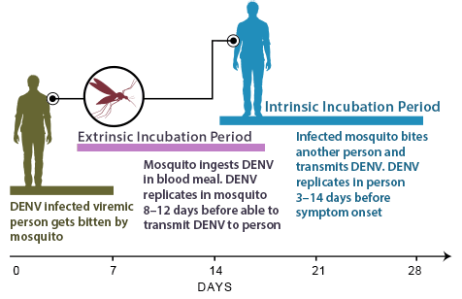
Intrinsic and extrinsic incubation period
https://www.cdc.gov/dengue/training/cme/ccm/page45915.html

Slide 13
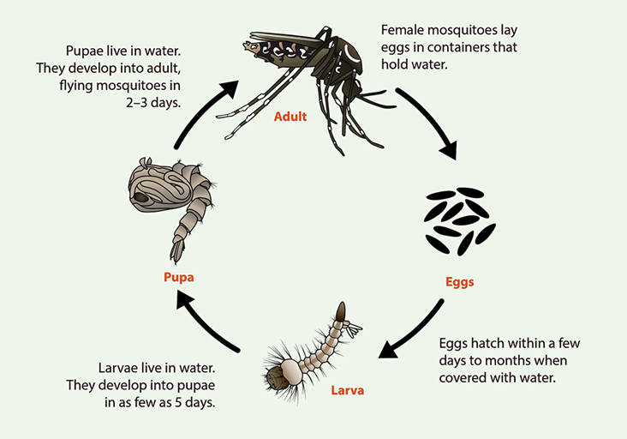
Replication cycle of the aedes mosquitoes
https://www.cdc.gov/mosquitoes/about/life-cycles/aedes.html

